Slide 1
CptS 327
Critical Infrastructure & BlackEnergy
Notes:
Template-WSU Hrz 201.ppt

Slide 2
Today’s Topics
Critical Infrastructure
  What? Why?
  Transition in device capabilities
    Subsequent change of predominant attacks
December 2015 Ukraine power grid cyberattack
Notes:
Template-WSU Hrz 201.ppt

Slide 3
Critical Infrastructure
What?
  An organization that provides access to critical resources
    Electricity, heat, water, internet
    Computing components are a part of the ‘critical infrastructure’
  Typical size
    Small: <1k devices || Medium: 1k to 10k devices || Large: 10k+
Why?
  Analog systems < Digital systems < Cyber systems
    Computing components maximize efficiency
    Provide increased safety and automation measures
    Costs of maintenance significantly reduced
Notes:
Template-WSU Hrz 201.ppt

Slide 4
Critical Infrastructure
Transition in device capabilities
  Analog: no networking
  Digital: some local networking
    Allows for communication between devices in a substation
  Cyber: modern networking
    Allows for global communication between devices
    Increased adoption from 2005 onwards
Attack predominance
  Pre-2005: insider threats
    Disgruntled employee, compromised employee etc.
  Post-2005: network-based cyber threats
    DDoS, file corruption via network commands etc
Notes:
Template-WSU Hrz 201.ppt

Slide 5
Critical Infrastructure
Why the shift in threat predominance?
  Engineers unskilled to deal with new cyber devices
  Lack of knowledge regarding maintenance cycles
    Patching / updates
    Production vs Testing environments
    Security configurations
    Authentication management
      0000, 1234, companyname etc are popular root passwords
Notes:
Template-WSU Hrz 201.ppt

Slide 6
Operation Sandworm
Sandworm?
  Name given to the Dec 2015 Ukraine Cyber attack
  First major cyber attack on a power grid
  30 substations were switched off
    230,000 people lost power from 1 to 7 hours
    $22.5 million estimated financial loss
Outline
  Compromise network via phishing emails
  Load BlackEnergy malware into the network
  Use BE to own control portions of the network
  Destroy backups, fry power supplies, control devices
  Corrupt or delete files
  Flood the network with spam
Notes:
Template-WSU Hrz 201.ppt

Slide 7
BlackEnergy
Features
  Dynamic and encrypted code (metamorphic)
    Hides processes in system driver (syssrv.sys) (jn.dll)
    Can invoke a botnet to flood ICMP, TCP, UDP, HTTP, and DNS (dds.dll)
    Can be remotely controlled (can take screenshots) (tv.dll)
    Can download and execute remote files (rd.dll)
      Enabling dynamic updates to prevent detection
    File system operations (fs.dll)
    Registry operations (si.dll)
    Logging (keystrokes) (kl.dll)
    Query and corrupt BIOS and other firmware (bsdc.dll)
    Network scanning for propagation (scn.dll)
    One switch kill (dstr.dll)
Notes:
Template-WSU Hrz 201.ppt

Slide 8
Operation Sandworm
Stage One – Infiltration (4-5 weeks)
  Identify a vulnerable engineer
    Use the company’s engineer roster and scan for weakness
  Compromise the employee using bait
    False alarm posing as the company’s CEO
      Other popular baits: Promotion, money, paid vacation…
  Spear-phish the compromised employee
    Make the target click a fake link
    Link leads to a fake but real-like website
    Engineer enters credentials on the fake website, steal credentials
Why an engineer? Why not any employee?
  Most CI companies have two networks
    Corporate: accessible by most company employees, outfacing
    Engineering: accessible by only the field engineers, no outface
Notes:
Template-WSU Hrz 201.ppt

Slide 9
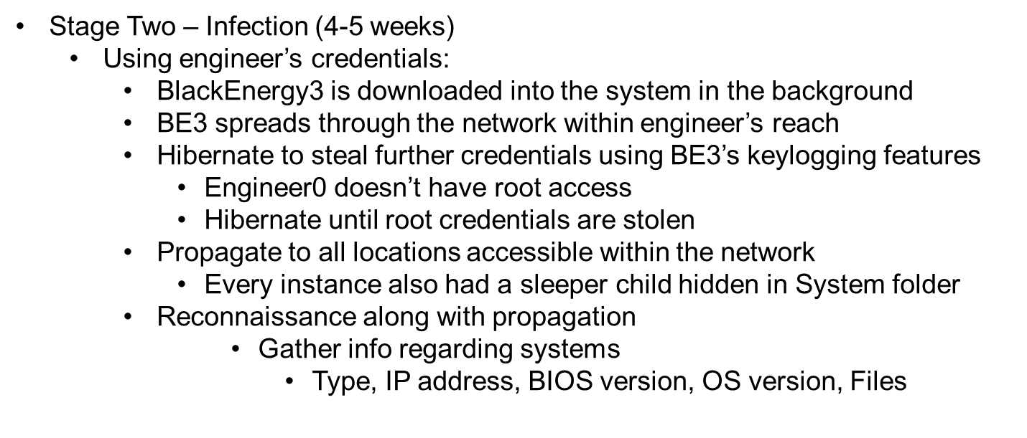
Operation Sandworm
Notes:
Template-WSU Hrz 201.ppt

Slide 10
Operation Sandworm
Stage Three – Destruction (few minutes)
  Using infected network:
    Destroy in the following order
      Flood networks by invoking botnets
      Delete backups by removing files
      Corrupt files and registries
      Corrupt firmware and BIOS
      Fry the power supplies by overloading (partial success)
Stage Four – Persist (few hours)
  Destroy rebooted systems by activating sleeper child
    Create a sleeper grandchild
      Repeat as long as possible
Notes:
Template-WSU Hrz 201.ppt

Slide 11
Operation Sandworm
Incidence Response
  First noticeable event is network flooding
    Can’t do anything via networks → Panic
  Mobilize personnel for physical access
    Files and registries corrupted
    Backups deleted
    Some devices shutdown due to BIOS/firmware corruption
    Some devices fried by overloading
What would you do?
The Ukrainian staff was well trained to deal with this situation
  Due to expected attacks from Russia and its allies
Analysts predict a total collapse of American power ecosystem if the same had happened in the US
  Many US companies started rigorous training and policy changes
Notes:
Template-WSU Hrz 201.ppt

Slide 12
Operation Sandworm
Incidence Response
  First noticeable event is network flooding
    Can’t do anything via networks → Panic
  Mobilize personnel for physical access
    Files and registries corrupted
    Backups deleted
    Some devices shutdown due to BIOS/firmware corruption
    Some devices fried by overloading
What did the Ukrainians do?
  Replace fried devices with hot switches
    Preconfigured replacements to ‘plug-n-play’ in case of a blackout
  Reboot corrupted devices and reflash backups stored on DVDs
The response measures took about 7 hours at full mobilization
Notes:
Template-WSU Hrz 201.ppt

Slide 13
Lessons Learnt
Invest time and money to:
  train employees to not fall for phishing baits
  Setup hot switches
    Yes, even if they may sit around unused for life
  Simulate attacks in a test environment and train employees to handle the attacks
  Create offline backup measures
    Memory drives disconnected from networks
    DVDs / CDs
Notes:
Template-WSU Hrz 201.ppt

Slide 14
Next lecture
The Stuxnet cyber weapon
Notes:
Template-WSU Hrz 201.ppt

Slide 15
Any questions?
Notes:
Template-WSU Hrz 201.ppt

